Slide 1
Cloud Computing
A Basic Introduction to Resources
Virginia Trueheart, MSIS
Texas Advanced Computing Center
vtrueheart@tacc.utexas.edu

Slide 2
Overview
What is Cloud Computing
What Can I Use It For
Choosing Systems
Images vs. Bare Metal
Using the Resources
Notes:
As a quick run down, I’ll cover what Jetstream is and how it is set up as well as how to access the system. I’ll then go more in depth about how to select and use images and make the most of your allocation.

Slide 3
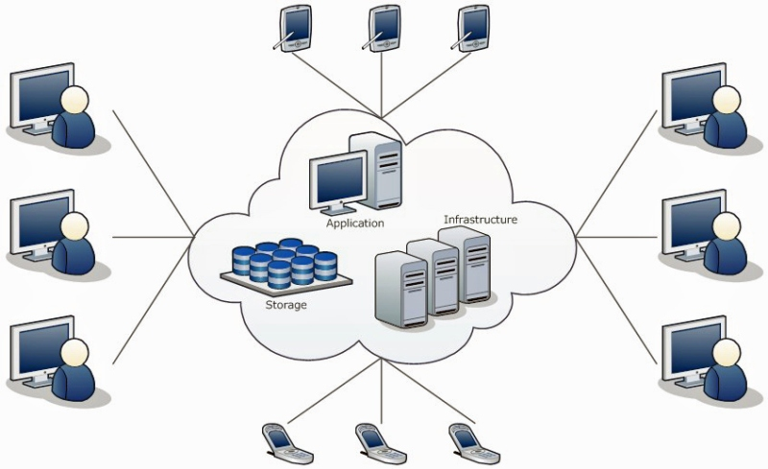
What is a Cloud?
A “cloud” is a computer system that provides users with shared access to on-demand computing resources via the internet.

Slide 4
Why is it Useful?
Resource Utilization
Scalability and Elasticity
Reproducibility by way of Programmability
Reliability through redundancy
Notes:
You only use what you need. If you need to scale or up or down based on activity then you can do that depending on what you’ve

Slide 5
Cloud vs. HPC
Cloud
Availability
Multi-level API Interactions
On-demand/Interactive Use
Using Commodity Components
HPC
Utilization
Capability or Capacity Science
Checkpoint/Restart I/O
Memory/Network Bandwidth & Latency
Notes:
If you have a lot of data you need to process or jobs that need to start and stop then use HPC
Commodity components computing: use of large numbers of already-available computing components for parallel computing, to get the greatest amount of useful computation at low cost. In other words it can snag what resources are free, different kind of queueing

Slide 6
Who Uses Clouds?
System Administrators
Help automate operations
Software Developers
Build applications on cloud servers and platforms
Computational Scientists
Write codes to analyze scientific data that resides in the cloud

Slide 7
Service Models
Infrastructure-as-a-service (IaaS)
Virtual servers, networks, firewalls, etc. (AWS, Azure)
Platform-as-a-service (PaaS)
Deploy application without managing virtual servers (Google App Engine, Heroku)
Software-as-a-service (SaaS)
Ready to use software applications (Gmail, Office365)
Functions-as-a-service (FaaS)
Run on demand without knowing the infrastructure (hook.io, AWS Lambda)
Notes:
Clouds vary greatly, you need to choose what you want to do. TACC runs two IaaS systems Jetstream and Chameleon. Jetstream has a “user friendly” interface and chameleon is “baremetal” meaning there’s no interface and no OS you have to build everything from the ground up

Slide 8
IaaS with Virtual Machines
Emulations
Gives the appearance of any typical personal machine
Simulates architectures
Operating Systems
Generally Linux in scientific communities but proprietary ones available through branded IaaS options
Software
Allows for installation of software in a way that generally doesn’t require building from the binary

Slide 9
Jetstream
NSF funded production cloud facility
On-demand interactive computing and analysis
Configurable environments
User-friendly, widely accessible cloud environment
Library of preconfigured virtual machines
Notes:
What is Jetstream? Jetstream is NSFs first production cloud facility. In short, this means you can access High Performance Computing via your web browser. It provides on demand computing resources to users that are in need of interactive sessions. Most traditional HPC computing is done via batch jobs which requires users to submit their work and then let it run unmonitored. Interactive computing allows users to make real time changes and more efficiently troubleshoot any issues. This is particularly valuable to new users who may still be learning how to use field specific software. Additionally, Jetstream provides fully configurable environments. Users have root access and can make any modifications they need and are not restricted by the administrative choices of a particular computing center. This system is designed to be user friendly in order to accommodate users of all experience levels and also make computing and analysis available anywhere. If you have an internet connection, you can run on Jetstream no special access is required. Finally, Jetstream hosts a large shared repository of images that can be deployed by any user. This makes it easy to get started and also provides templates for users to go on and build more complex images customized to their work.

Slide 10
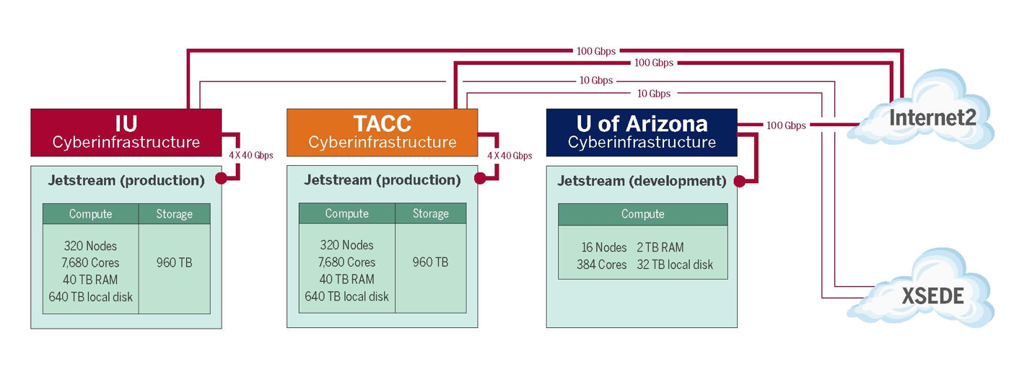
Architecture Overview
Notes:
Jetstream is providing a lot of the these examples because it’s the system I have direct access to and can describe but you can transpose a lot of this onto other systems at different scales

Slide 11
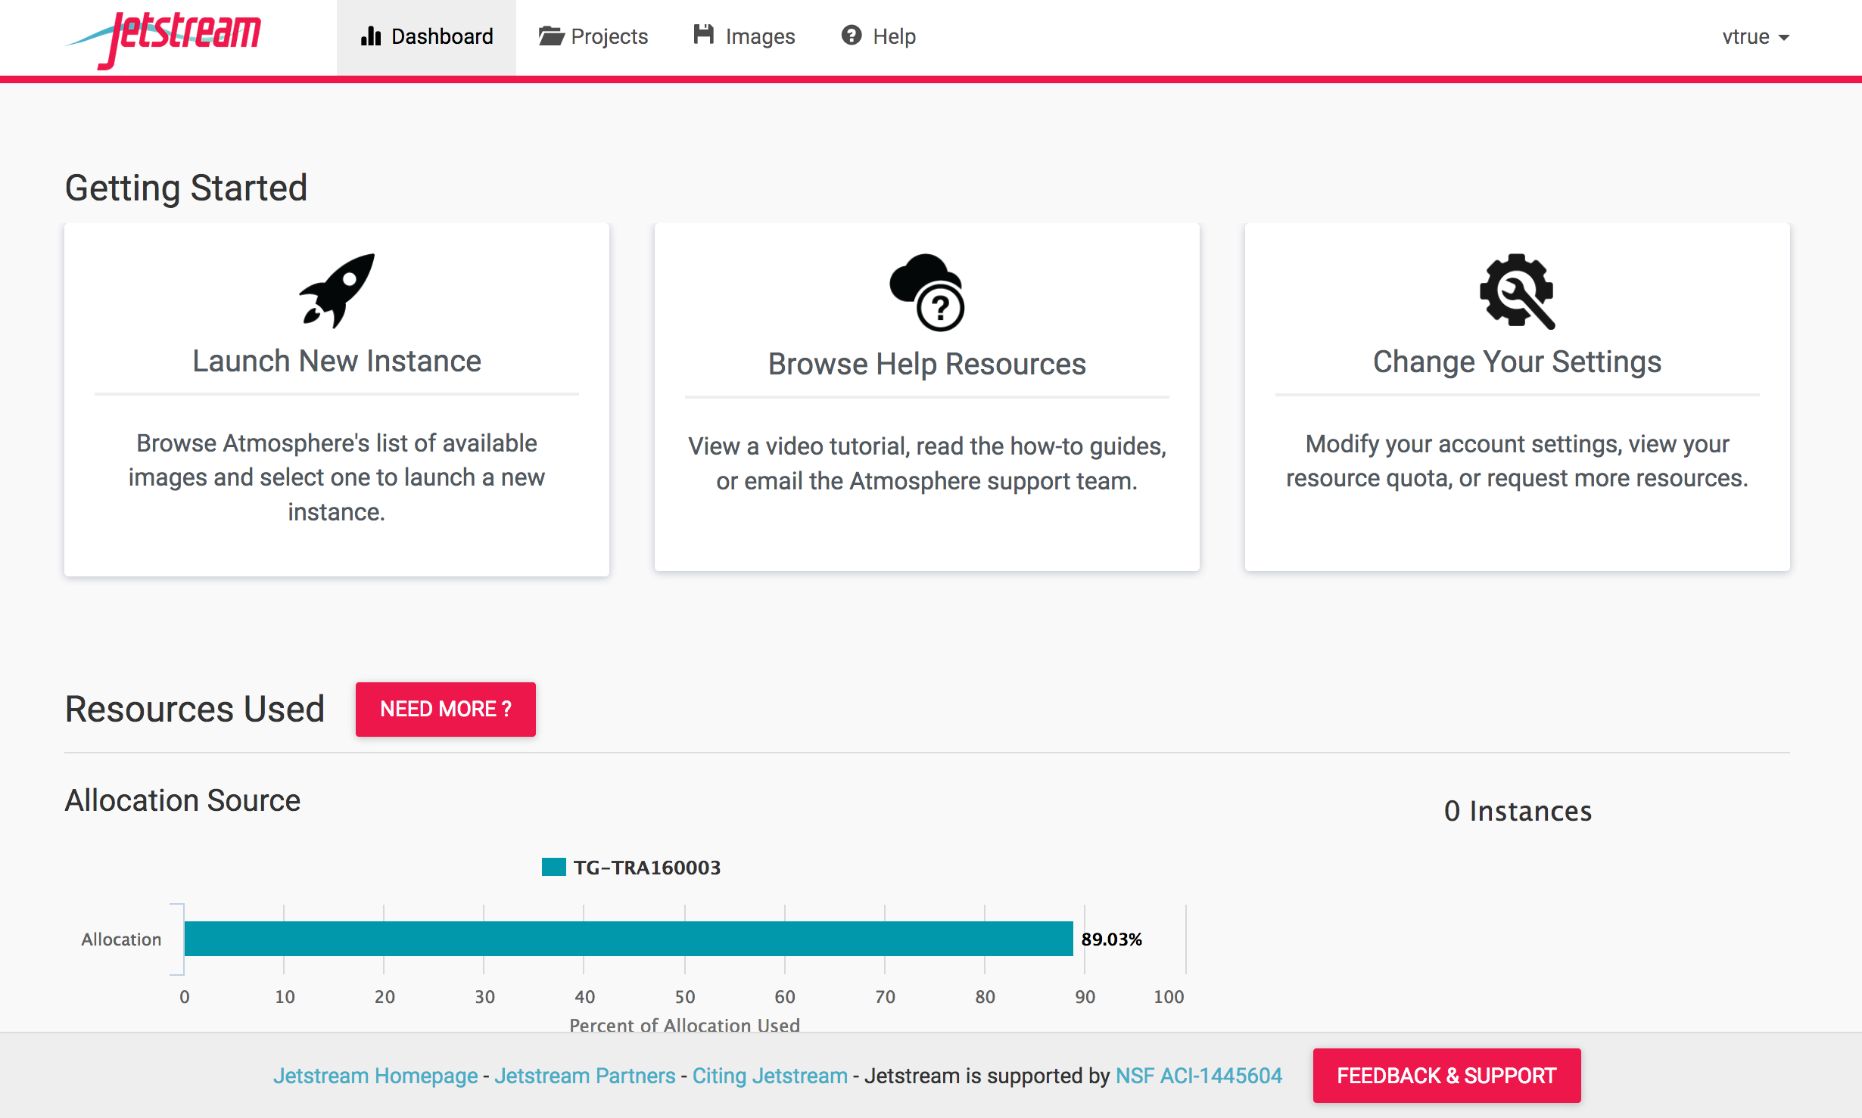
Notes:
Be aware of how much you have in the way of resources, either via grant or what you are paying. Over use can result in loss of time or content if you get caught out.

Slide 12
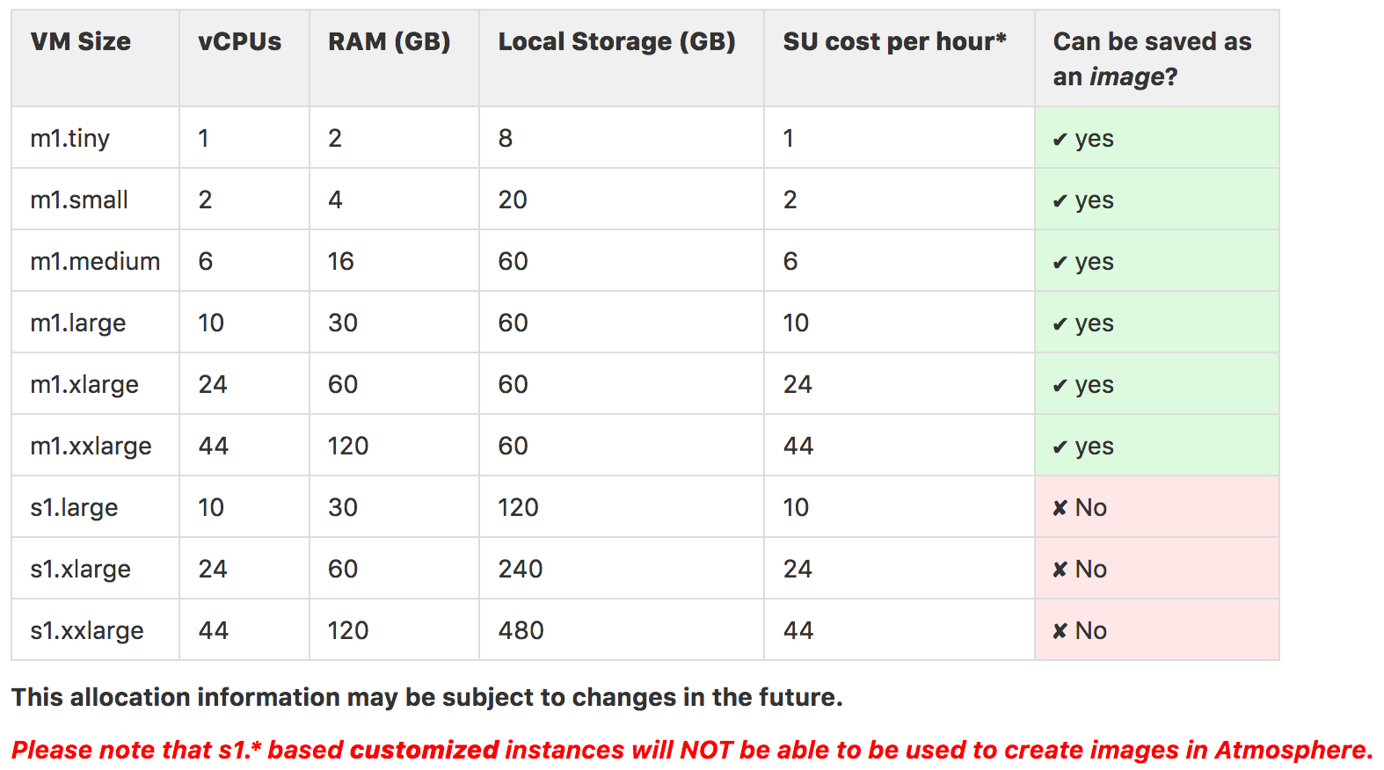
Virtual Machines
These configurations are available when choosing a VM.
You should always request the smallest VM size that can accommodate your work.
Local storage is ephemeral and will be lost when your session dies.
For long term storage you will need an XSEDE-allocated Volume.
Notes:
Here’s an example of different kinds of VMs that might be available

Slide 13
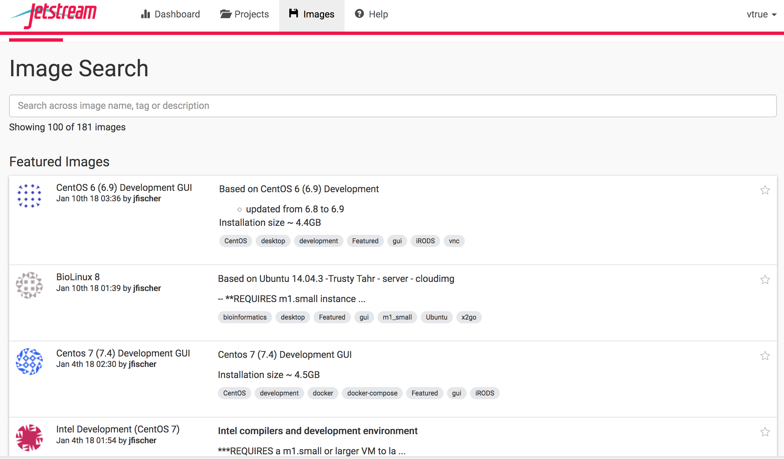
Images
Notes:
In order to launch an instance, you will need to choose an image by going to the Images tab. There are a wide variety of images available and users add new public images regularly. If you know you need a specific piece of software like Matlab or Anaconda, then you can search for those terms and select an image that meets your needs from the tagged images. There are an immense number of tag options so feel free to dig around and see which ones apply to you and what other people find useful in their images (bioinformatics, specific operating systems, software, docker containers, etc)

Slide 14
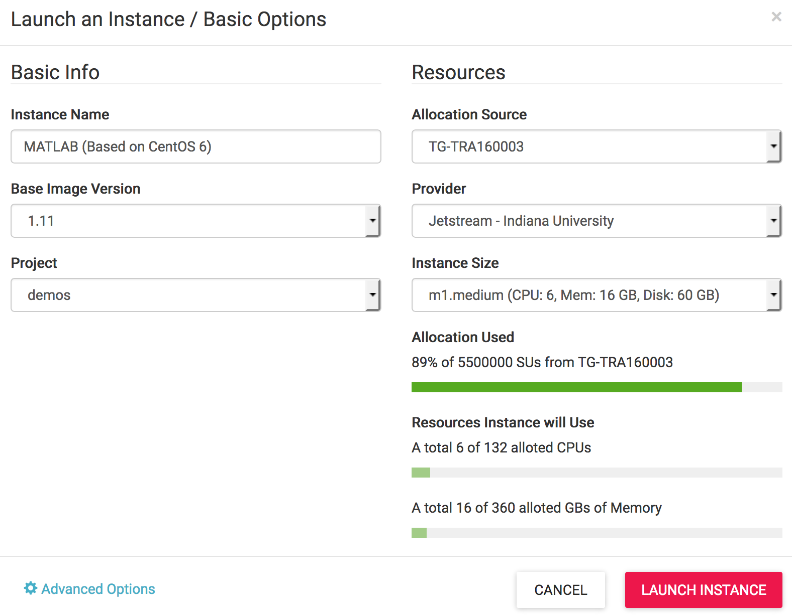
Images cont.
Notes:
After clicking Launch you will need to select options specific to the instance you want to run. In this case, I want to use v. 1.11 instead of an older version, I’m going to run on the nodes at IU and I want an m1.medium VM. This is also actually an example of an image that’s bound to a specific provider and IU is the only option available in the provider drop down. The same goes for the instance size. Since this requires an m1.medium or larger, the smaller options are not available in the drop down. Once you’ve configured the image to your liking, click launch instance at the bottom.

Slide 15
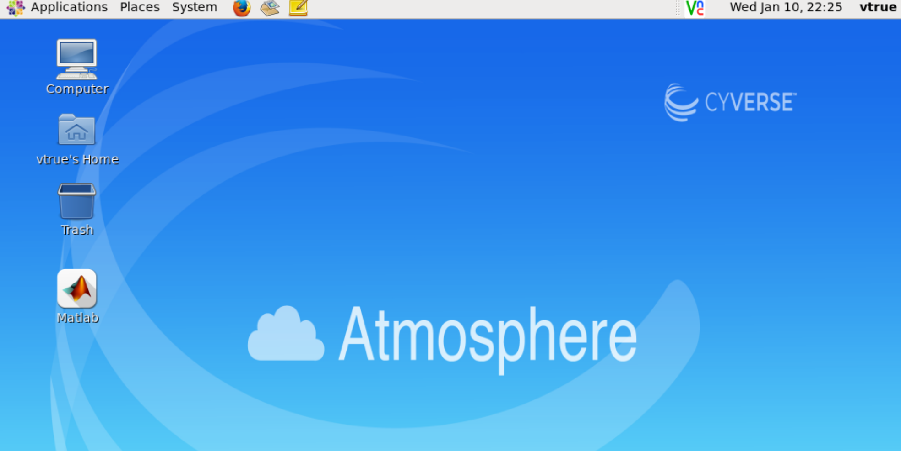
Images cont.
Notes:
So I've clicked on Open Web Desktop and as you can see it looks exactly like any other desktop, but has the added bonus of being preloaded with Matlab (extra added bonus, no license needed). You can now double click on matlab to open the application and run the software exactly as you would on your own machine. Depending on the size of the VM you selected, you should be able to run much larger computations than you would on your personal laptop since you’ll have access to more CPUs. Jet stream uses atmoshphere api for this interaction and display

Slide 16
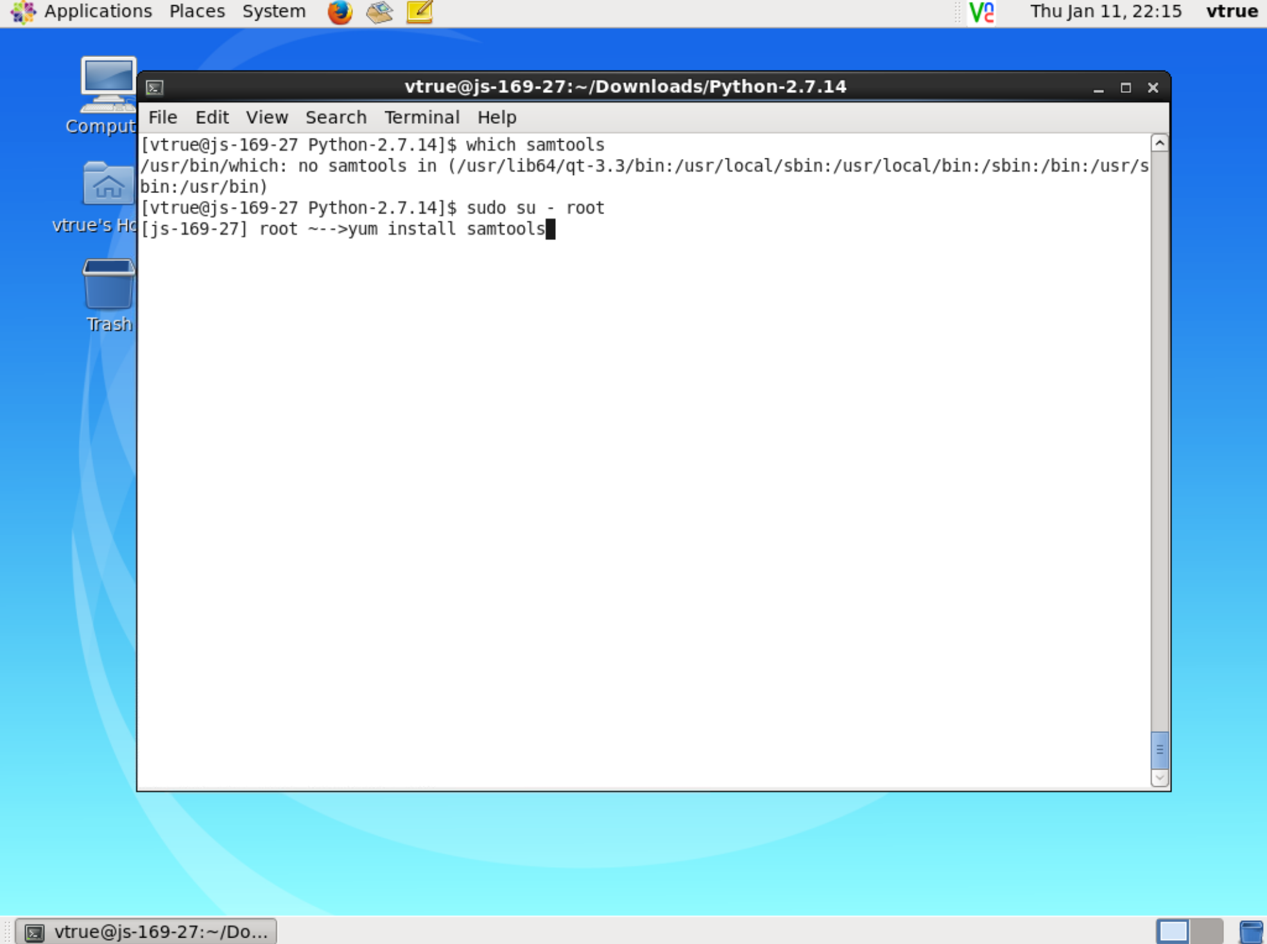
Modifying an Image
Notes:
Now we’ll take a look at how to modify a base image to meet your personal requirements. This particular display, while similar to the last, is of a basic CentOS 6 Development image (no matlab). I’ve opened up the Web Desktop again, and then opened a terminal emulator which is under the Applications menu at the top under System Tools. Because this Image is basically a blank slate, it doesn’t have the samtools package that I want to use in post processing of some DNA sequences. Since I have root access when using a VM I can sudo to root and make use of yum to install samtools.

Slide 17
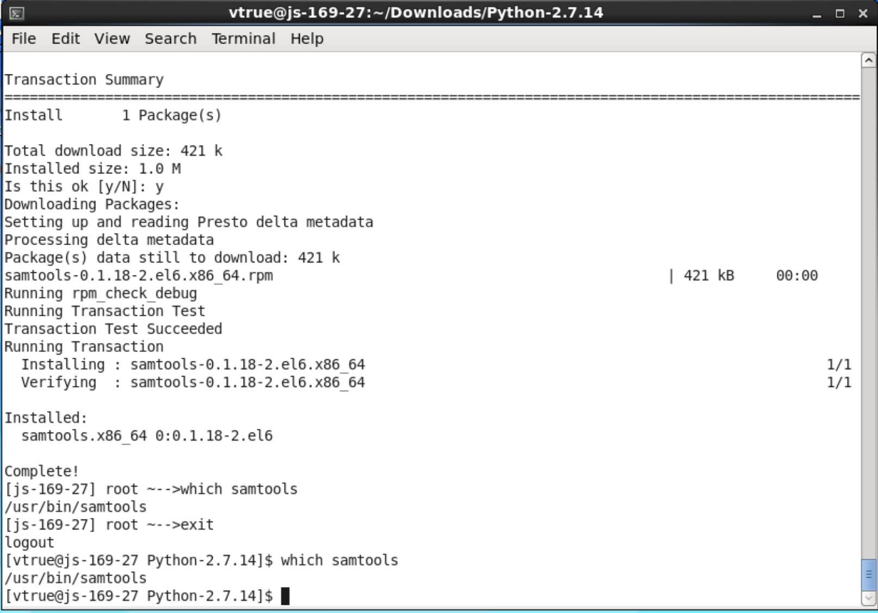
Modifying an Image cont.
Notes:
So the yum install works and now Samtools is available everywhere on this image.

Slide 18
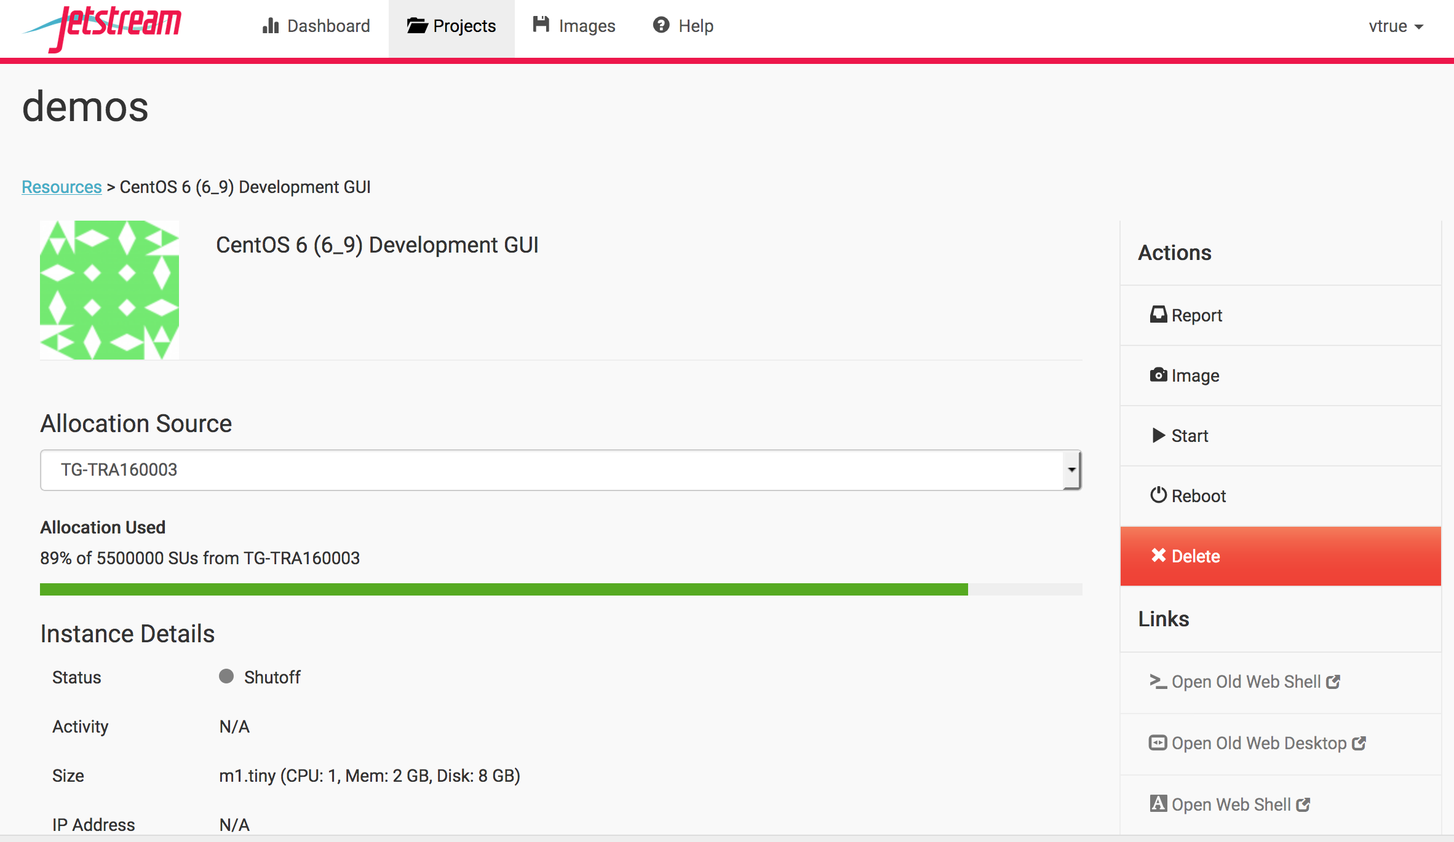
Saving an Image
Notes:
Now that this image has samtools added to it, I want to save it so I can reuse it later without having to reinstall the software. In order to save an image, the instance must be active or stopped. Here you can see, I’ve stopped the instance and now I’m going to select Image under the Actions menu to save it.

Slide 19
In Summary
The longer your instance runs the more SUs you consume
Be aware that you are on a shared resource
You have root access, but the original image stays intact
This is only the basic level of what you can do with Jetstream; there are many more options available in the Wiki
Notes:
So that's the general run down on how to use Jetstream. A few reminders: The more resources you request and the longer you run the more SUs you consume and the faster you’ll run through your allocation. You’ll also be holding resources that other people may be waiting to use. If you need to run for extended periods of time, you certainly can but it’s best to keep limited.
While you can make any changes you want via root access, if you don’t save the image, everything will be lost once you kill the instance. Back up your work or you’ll have to start from scratch.
The wiki has detailed descriptions of even more functions for jetstream and also provides a link to the jetstream forum where you can confer with other users.

Slide 20
IaaS with Bare Metal
Direct access to the node
Choose how you want to interact with the system
Build your own interface
Select and install your own OS
Install software to your exact specifications
OpenStack
Cloud based OS to help control your environment
Provides dashboard based management in addition to command line
Notes:
Openstack is also available on Jetstream but it becomes more necessary on a bare metal system because of the lack of a large VM library. You need to pull from outside sources if not building your own from scratch. Less storage in baremetal as well since the point is the access to the hardware. This isn’t necessarily where you want to store a large data set for others in your field

Slide 21
Chameleon
Select the hardware you want
Instead of images you can select ‘flavors’ to determine memory, cpus, root disk, etc
Network options
Generate IPs for external access
Develop APIs
Use APIs to provide dashboards, monitor activity, etc
Notes:
Application programming interface

Slide 22
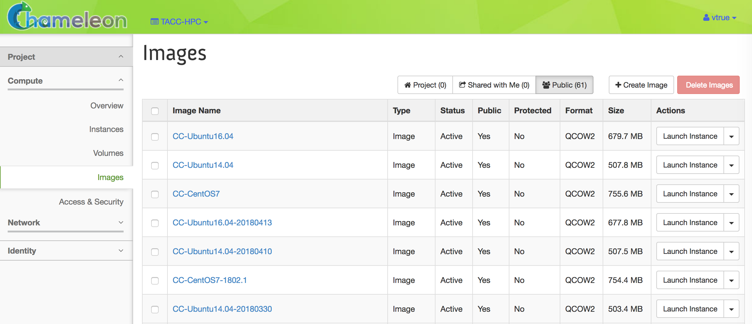
OpenStack
Notes:
Since tacc provides open stack for chameleon there are some images available like on Jetstream

Slide 23
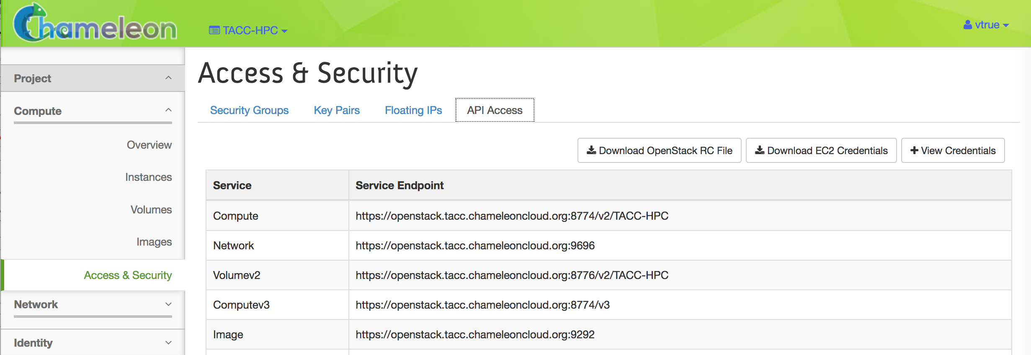
APIs, SSH, and IPs
Notes:
This can be controlled through openstack as well. Controls who can talk to your instance.

Slide 24
Command Line Access
Install OpenStack
Install python
pip install python-openstackclient
Download an RC File
Pull from your Chameleon account
source <path/to/openstack_rc_file>
If you are a Windows user you’ll need to manually provide environment variables

Slide 25
For Mac
vtrue-mbpr:~ vtrue$ python --version
Python 2.7.15
vtrue-mbpr:~ vtrue$ pip install python-openstackclient
Collecting python-openstackclient
Downloading https://files.pythonhosted.org/packages/33/84/c739b13aacc47d887cae58acc7dd921240918aa20a9add6ab64d932d1a6a/python_openstackclient-3.15.0-py2.py3-none-any.whl (823kB)
100% |████████████████████████████████| 829kB 8.0MB/s
Collecting oslo.utils>=3.33.0 (from python-openstackclient)
Downloading https://files.pythonhosted.org/packages/6c/bb/308293b06400625b721795657c0c50c8a5942fde58d9532b40f57758a158/oslo.utils-3.36.2-py2.py3-none-any.whl (91kB)
100% |████████████████████████████████| 92kB 4.6MB/s
Collecting osc-lib>=1.8.0 (from python-openstackclient)
Downloading https://files.pythonhosted.org/packages/de/b7/91ed1a58756390fa006a5777ceb44578f021a9b67ffec0729f5037fff51a/osc_lib-1.10.0-py2-none-any.whl (81kB)
100% |████████████████████████████████| 81kB 17.4MB/s
Collecting python-glanceclient>=2.8.0 (from python-openstackclient)
Notes:
This you want to do on your local machine this isn’t like logging into an HPC machine and running there so you have some root access etc no need for –user

Slide 26
For Windows
openstack --os-auth-url <OS_AUTH_URL> \
--os-project-id <OS_PROJECT_ID> \
--os-project-name <OS_PROJECT_NAME> \
--os-user-domain-name <OS_USER_DOMAIN_NAME> \
--os-username <OS_USERNAME> \
--os-password <OS_PASSWORD> \
--os-region-name <OS_REGION_NAME> \
--os-interface <OS_INTERFACE> \
--os-identity-api-version <OS_IDENTITY_API_VERSION>
Notes:
Replace values of the parameters by reading from the OpenStack RC script.

Slide 27
On the Command Line
vtrue-mbpr:~ vtrue$ openstack
Readline features including tab completion have been disabled since no
supported version of readline was found. To resolve this, install
pyreadline on Windows or gnureadline on Mac.
(openstack)
There are options available in the command line that are not available in the GUI
Gnocchi metrics
Advanced networking
Notes:
Gnocchi metrics: the storage and indexing of time series data and resources at a large scale. rather than storing raw data points, it aggregates them before storing them. This built-in feature is different from most other time series databases, which usually support this mechanism as an option and compute aggregation (average, minimum, etc.) at query time.
Because Gnocchi computes all the aggregations at ingestion, getting the data back is extremely fast, as it just needs to read back the pre-computed results.
This is the part you need to do if you need storage on baremetal

Slide 28
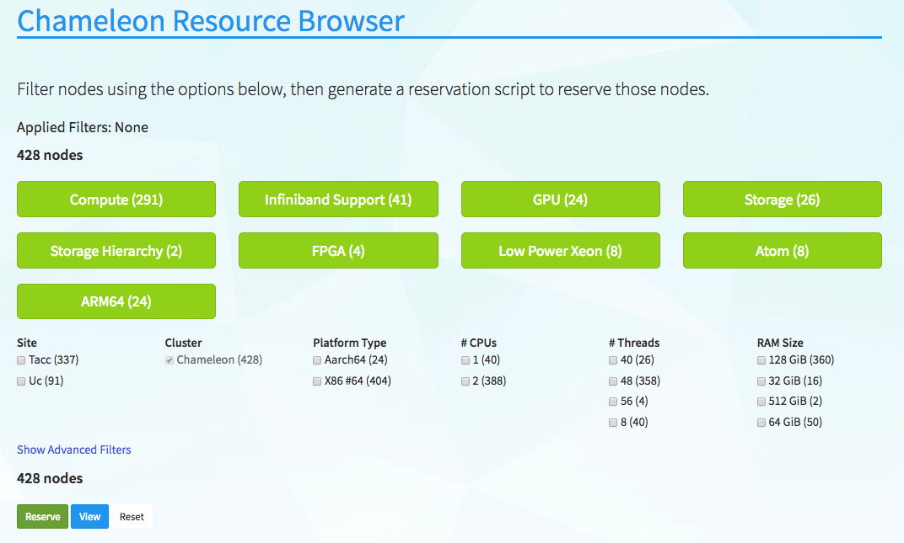
Selecting Hardware
Notes:
You can see there are similar kinds of things that are available on an HPC machine but you need to know what you need
You may filter for specific node types by selecting the checkboxes that match your filter criteria or by clicking the buttons such as Compute and Infiniband Support. The numbers printed next to the node types indicate the total number of nodes of that certain type. After you have selected filter criteria, you can click the View button to see details of individual nodes that match your filtering criteria.

Slide 29
Check on Resources with REST API
vtrue-mbpr:~ vtrue$ curl -i https://api.chameleoncloud.org/
HTTP/1.1 200 OK
Server: nginx/1.6.2
Date: Tue, 12 Jun 2018 22:35:34 GMT
Content-Type: application/vnd.grid5000.item+json; charset=utf-8
Content-Length: 757
Connection: keep-alive
Allow: GET
...
{"type":"grid","uid":"chameleoncloud","version":"0aa787fa5c97c34bd0b7a583d4e2fab693010daa","release":"3.5.7","timestamp":1528842934,"links":[{"rel":"sites","href":"/sites","type":"application/vnd.grid5000.collection+json"},{"rel":"self","type":"application/vnd.grid5000.item+json","href":"/"
Notes:
Curl will help you check what is available and help you select clusters from the command line

Slide 30
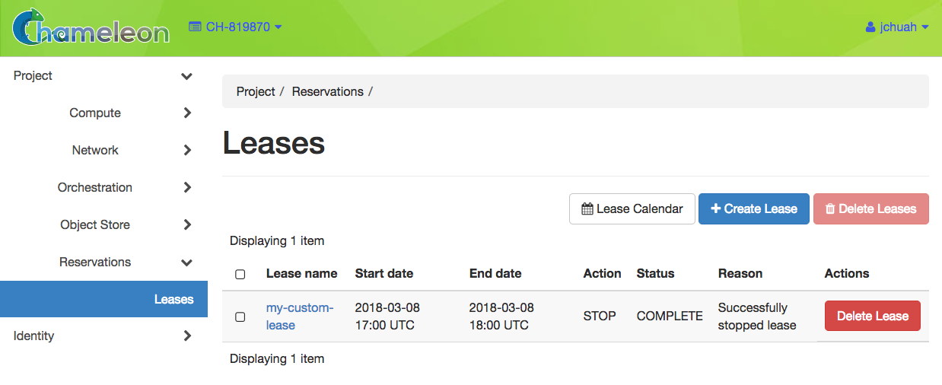
Reservations
Notes:
You will frequently need to reserve a space on a smaller system like this. Something like AWS will likely be able to spin you up almost immediately but the interfaces for options are very similar. You need to select your options and put in your requests.

Slide 31
Complex Appliances
Complex Appliances allow you to specify not only what image you want to deploy but also on how many nodes you want to deploy that image, what roles the deployed instances should boot into (such as e.g., head node and worker node in a cluster), what information from a specific instance should be passed to another instance in that Complex Appliance, and what scripts should be executed on boot so that this information is properly used for configuring the “one click” cluster.
Notes:
In other words, if you want to set something up so that it’s easy for OTHER people to use, you’ll likely need to deploy complex appliances

Slide 32
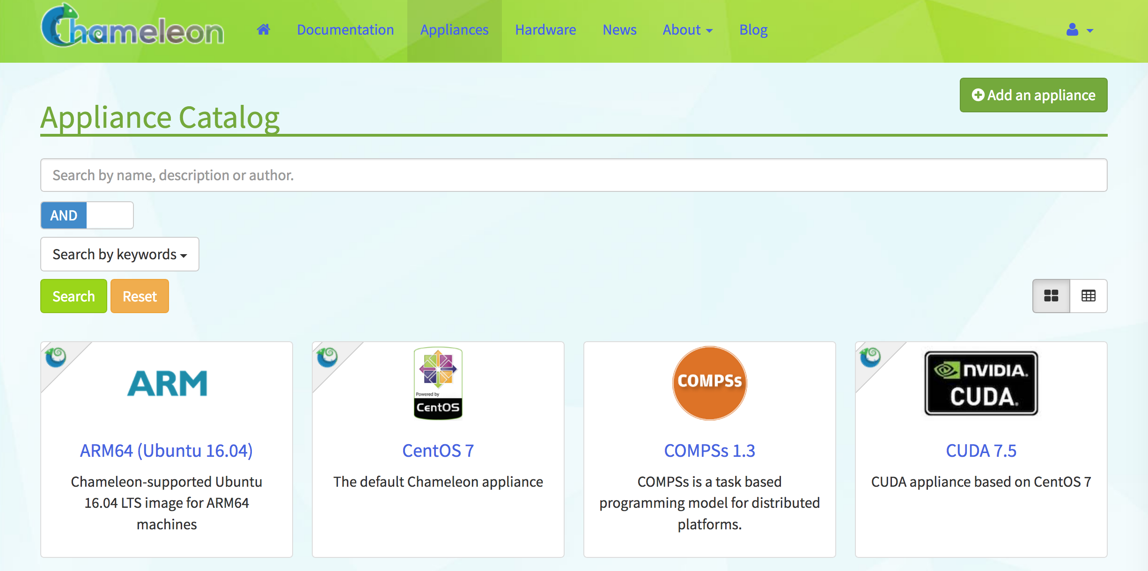

Slide 33
Managing and Monitoring
Need to be launched the same way an Image is
Select the Stack from the GUI once it is up
SSH to it with a floating IP just like with an Image
You can also do this from the command line with OpenStack

Slide 34
Q&A
https://chameleoncloud.readthedocs.io/en/latest/technical/index.html
https://iujetstream.atlassian.net/wiki/spaces/JWT/pages/17465367/System+Overview

